Slide 1




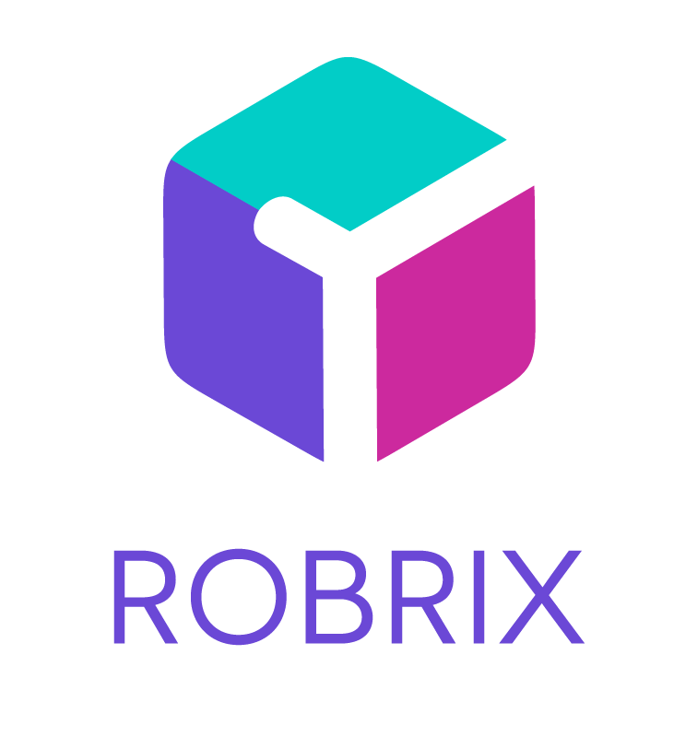


a complex, multi-platform app in Rust for secure chat using
Kevin Boos, PhD
Architect @ Futurewei Technologies

Slide 2


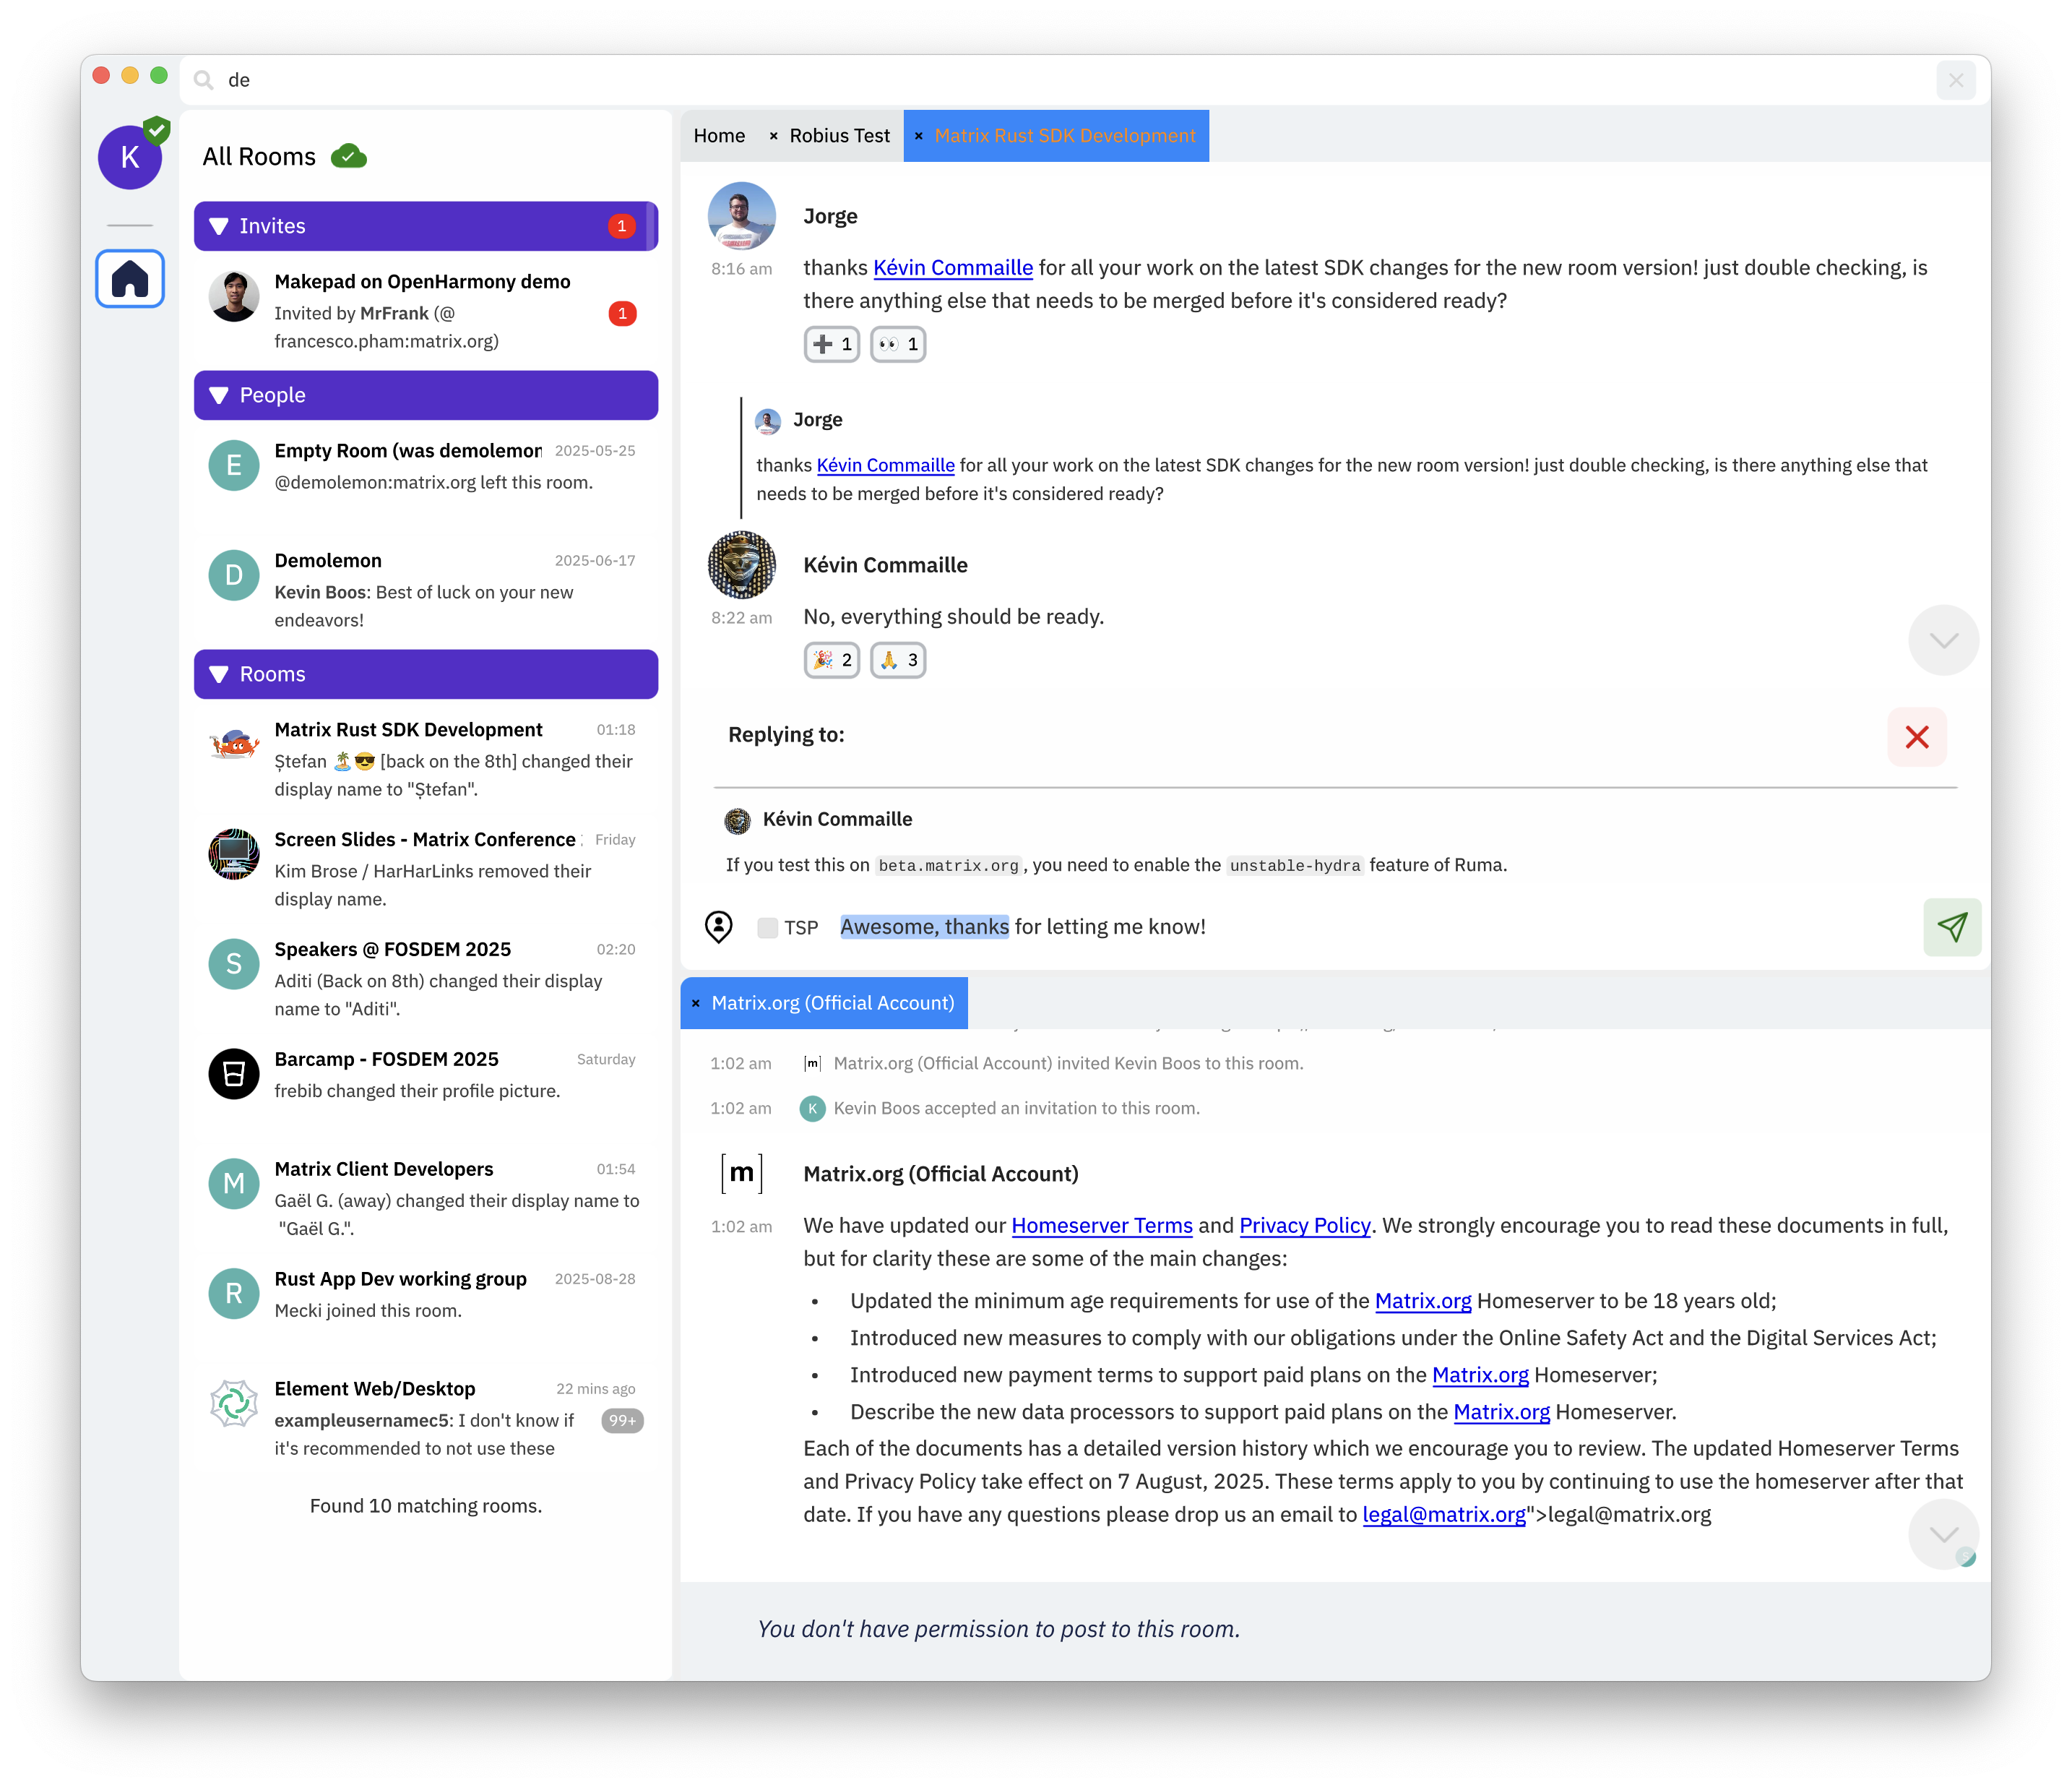

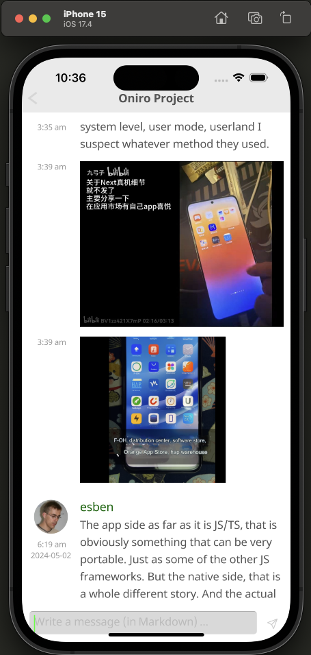
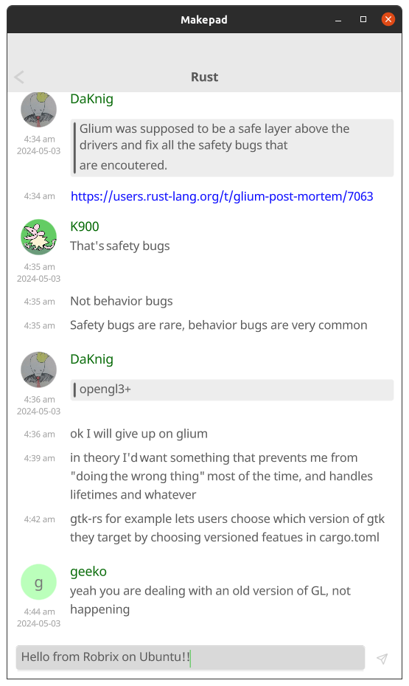
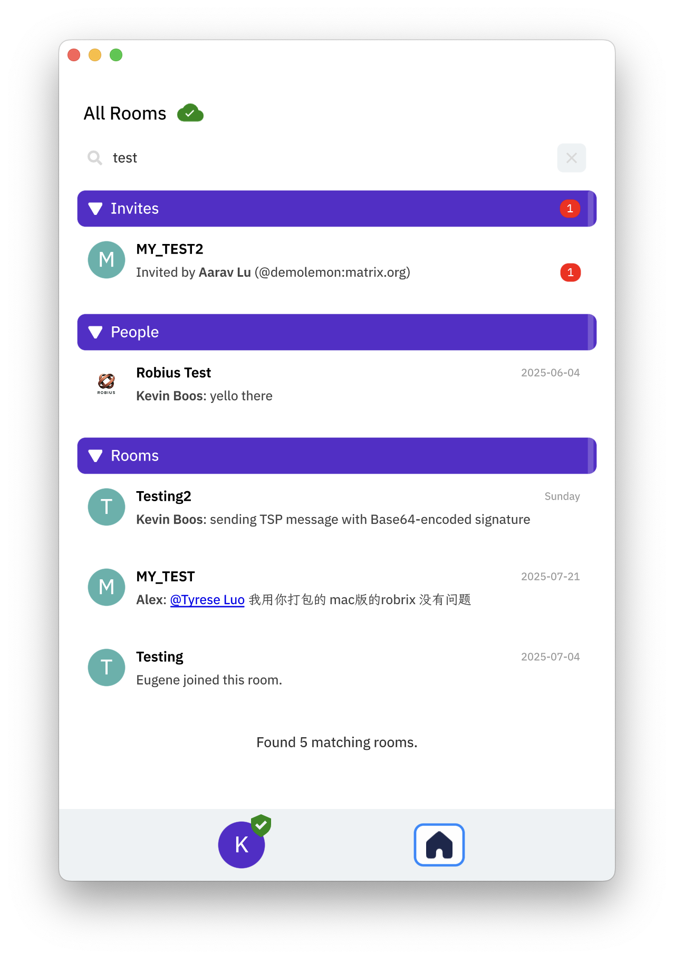

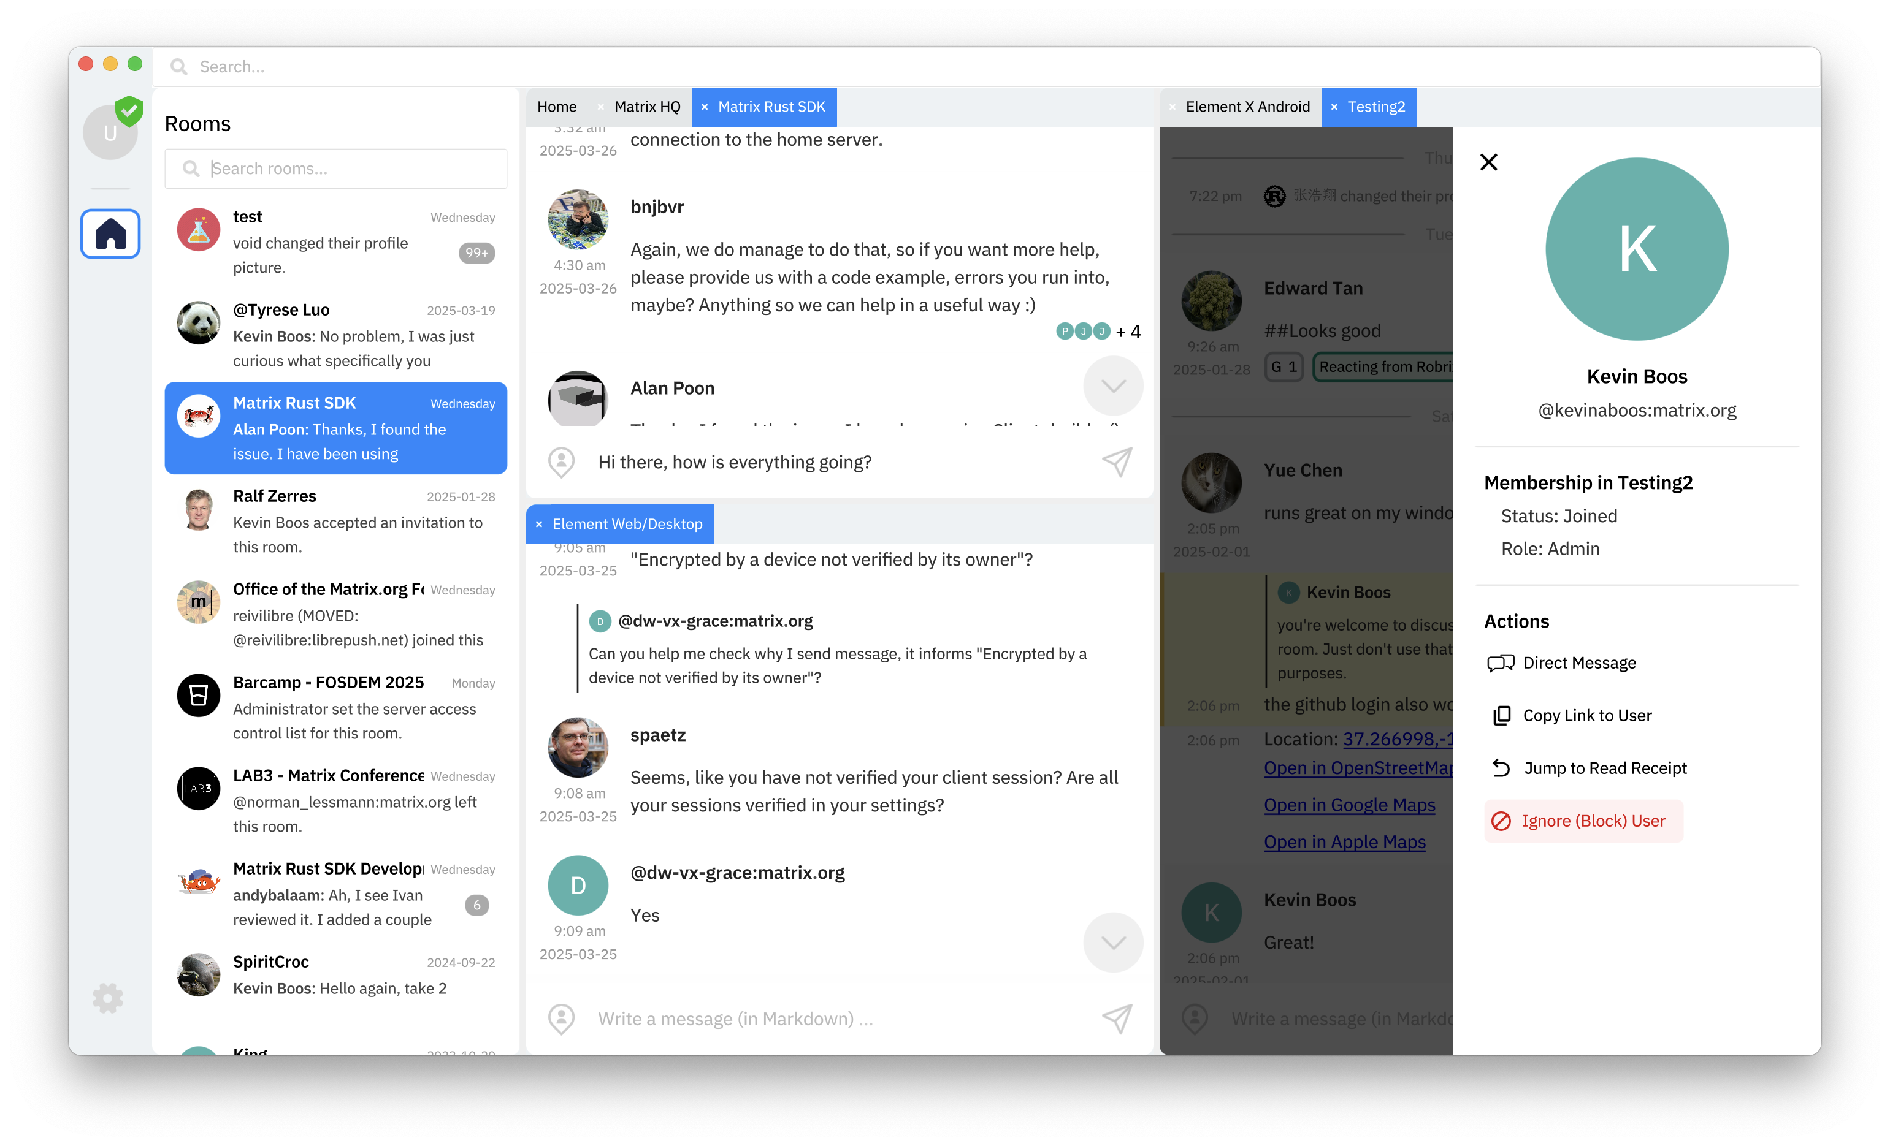
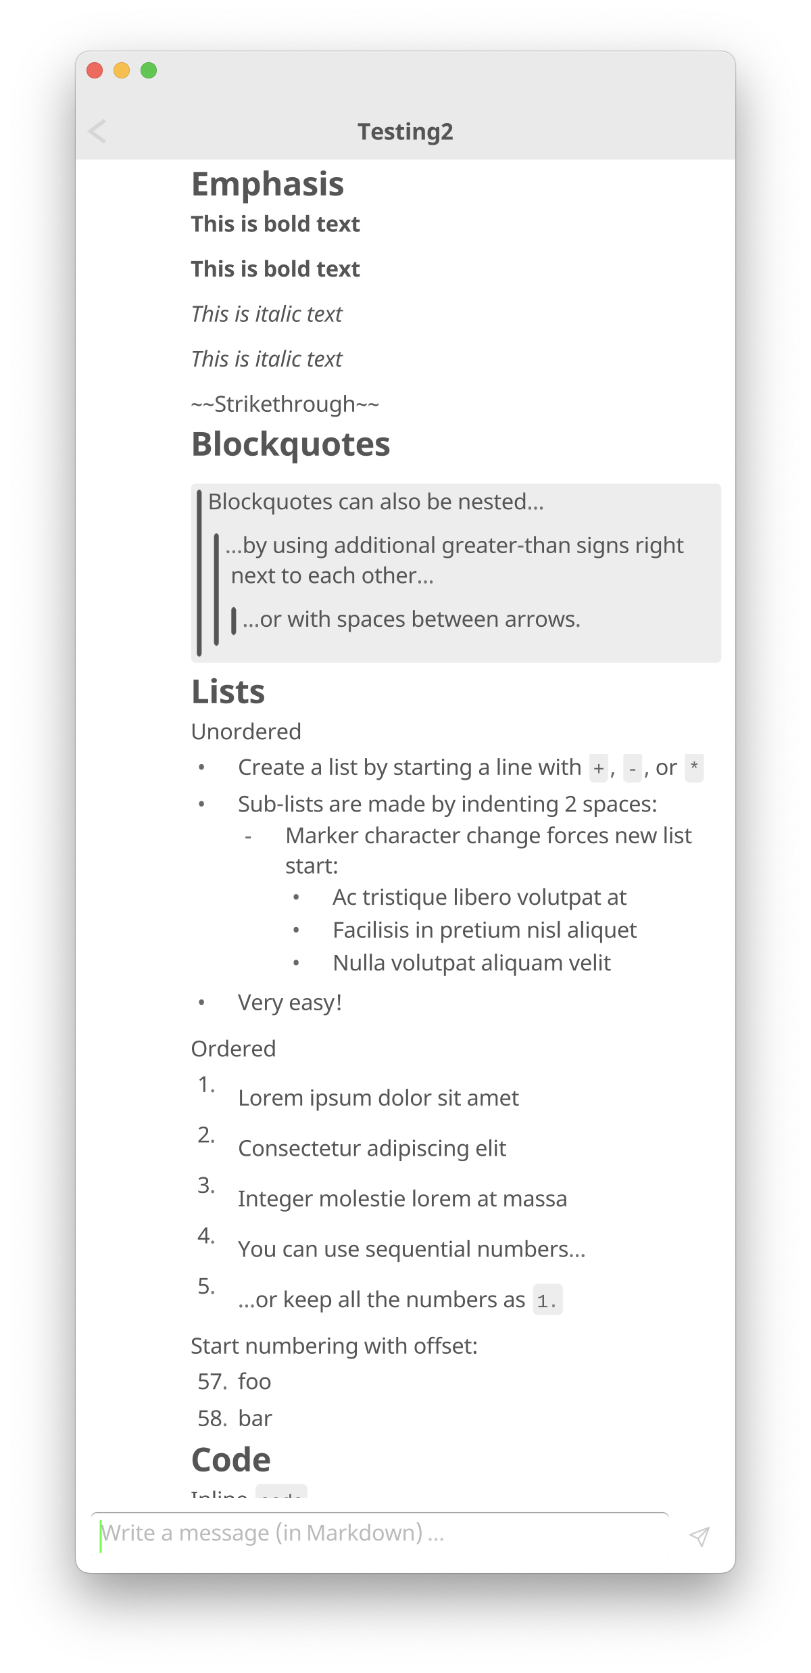
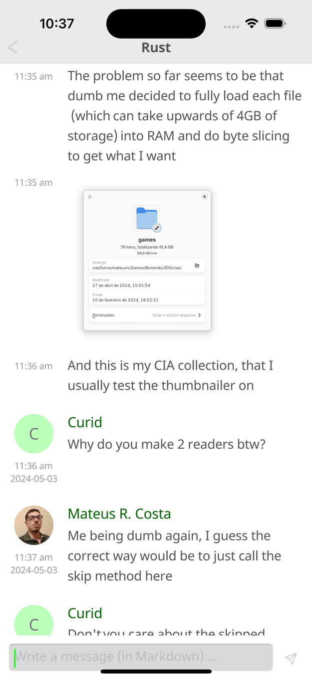
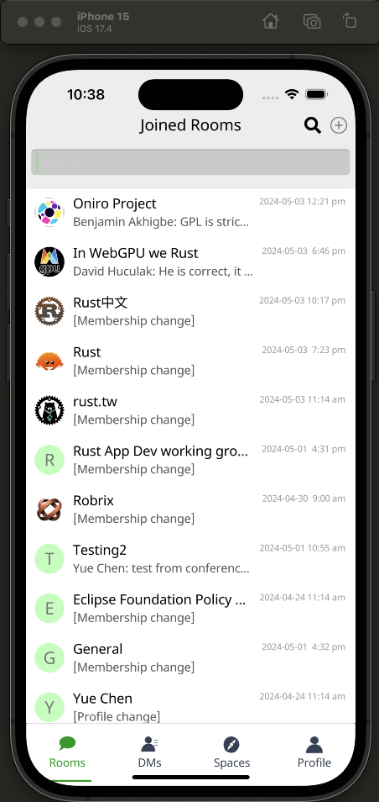
+
one code base, one language ,
many platforms!

Slide 3



You can now build complex apps in pure !
Robrix is built on a strong Rust-only foundation:
akepad – high-performance GPU-based UI toolkit with live reload, custom shader styling obius – abstractions of platform features / OS services, build tooling, and more

Slide 4
Background & Motivation

Slide 5

High-performance UI framework in pure Rust
Custom DSL for UI design: mixed immediate + retained mode
Shader-based styling with built-in hot reload
Lightweight & efficient; ~10-second compile time
Supports mobile + desktop + web + VR: iOS & Android, macOS, Windows, Linux, WASM, Meta Quest
And recently, OpenHarmony too! (in progress)
Makepad at a glance

Slide 6
Provide everything else needed for app dev beyond the UI
Fill in missing support for many platform-provided features
Make Mobile a first-class concern in the Rust community
The Rust experience has felt neglected on Mobile
Bring frontend devs to Rust, and app dev to Rust users
leverage the robust, safe, and performant Rust ecosystem
avoid dealing with multiple languages/environments
never write a single line of platform-specific code
Devs can:
Project Robius at a glance

Slide 7
Makepad + Robius = better Rust app dev
Makepad recently released v1.0 (May 2025)
5+ years of active development, still improving every day
However, there’s more to app dev than just drawing a UI
This need fostered a joint collaboration with Robius, ongoing since 2023
Both are fully open-source, decentralized, and community-driven
Independent collaborators across US, Europe, South America, China
All components written entirely in Rust, for Rust devs
Direct, lightweight use of native platform APIs, no heavy deps like underlying web engines or bridges
Subverts the older app style of “less Rust, more other code” (a small Rust core surrounded by big platform-specific wrappers)

Slide 8
What is and why did we choose it?
“An open network for secure, decentralized communication”
Similar to 钉钉/DingTalk, Microsoft Teams, Discord, Slack, but open & federated
We needed a “killer app” to drive Robius development
“What kind of app is highly demanding?” (of UI & platform abstractions)
A modern chat client!
Requires network, geolocation, storage access for files/images, multimedia capture & playback, system notifications, clipboard, connectivity mgmt., rich text formatting & input, persistent device storage & cache, biometric authentication, secret key storage, and so much more!
Why Matrix? It’s also open-source, decentralized, and Rust-oriented ✅

Slide 9
Structure of a Robius app

Slide 10
How do Makepad + Robius fit together?
Application
UI logic
UX logic
Application logic
Business logic
UI toolkit (Makepad)
Robius Platform Abstractions
Only runtime components are shown.
Build tooling is not shown.
Concurrency Mgmt library
Storage
Location
Cache
Multimedia
Widgets
Power
Permissions
Connectivity
Sensors
main UI thread token
async tasks
Animation
Actions
URI Handling
Keychain
Dialogs
Notifications
Events
Drawing
Open/Share
Timer/Alarm
Drag & Drop
Clipboard
bkgd thread workloads
comm. primitives
FFI layer (Rust → native language)
Platform/OS Native Layers (Linux, macOS, Windows, Android, iOS, Web, OpenHarmony …)
Notes:
Our primary goal is to establish a complete, working example of everything beneath the app
Which must support major platforms/OS environments
UI toolkits – Makepad, Dioxus, Slint
Offers a variety of UI development options and styles
Generally cross-platform, with a focus on GUI design and workloads
Rust abstractions of platform and OS-specific functionality
Focus on non-GUI subsystems
Standard subsystems: networking, storage, audio, time
UI-adjacent services: notifications, clipboard, drag & drop
Mobile-oriented:
Sensors/actuator: accelerometer/gyro, ambient light, pressure, temp, vibration, location, buttons, LEDs, biometrics
Multimedia: camera, mic, speaker
Touch screen, display brightness
Connectivity: WiFi discovery, bluetooth, NFC, USB, phone modem
Power: battery, charging, idle/standby/awake status
Permissions management: declaring, requesting, revoking
Goal: easy to integrate into a UI app as a dependency
Low-/zero-cost abstractions, as close to native as possible
Future: high-level, off-system mobile services
RESTful APIs: mapping, authentication, Google Play services, etc
Can likely use or start from the foundation of Open Mobile Hub
App dev-focused Concurrency management framework/library
Speaking from personal experience, it can be quite cumbersome and difficult to integrate and balance together many different execution contexts
Async tasks, which many SDKs force upon the user
Native OS Threads
The almighty main UI thread, which often has significant platform-enforced responsibilities and powers – difficult to handle and properly remember what workloads can only be run on the main UI thread
Balancing
Communicating between all of these different contexts without
thread pools, and CPU/multicore abstractions

Slide 11
Application
Application
UI / UX
Architecture of the Robrix App a Matrix chat client
Robrix’s needs guide Robius development and implementation priority
Writing & using Robrix forces us to dogfood Robius components
and Makepad, of course
Added many new features to Makepad over the past ~2 years to support Robrix
Rooms list
Room view
Rooms browser
Application logic
Business logic (SDK use & more)
Persistent settings
Show notifs.
Local msg search
Jump to event
Event query
Join/ leave room
Send/recv messages
Read receipt
Settings, Themes
In-app notifs.
Context menus
Member info
Image viewer
Video display
Create, modify room
Quick replies
Access camera, mic, speaker
Login, session management
Account management
Reactions, read receipts
Search
Rich text format
Multimedia upload/mgmt
Input reaction
File/media dialog
Authentication,
verification
Threaded view
UI ↔ SDK communication
and more!
UI toolkit (Makepad)
Concurrency Mgmt library
Platform Abstractions
Concurrent Runtime
async executor, multithreading, thread pools
thread token: &mut Cx
Networking
Location
Storage/Cache
Multimedia
Widgets
async task pool
Input Events
Keychain
Connectivity
Notifications
Animation
Actions
channels, segqueues, etc
Authentication
Permissions
Dialogs
Clipboard
Events
Drawing
thread-local caches
FFI layer (Rust → native language)
Platform/OS Native Layers
11
Notes:
Our primary goal is to establish a complete, working example of everything beneath the app
Which must support major platforms/OS environments
UI toolkits – Makepad, Dioxus, Slint
Offers a variety of UI development options and styles
Generally cross-platform, with a focus on GUI design and workloads
Rust abstractions of platform and OS-specific functionality
Focus on non-GUI subsystems
Standard subsystems: networking, storage, audio, time
UI-adjacent services: notifications, clipboard, drag & drop
Mobile-oriented:
Sensors/actuator: accelerometer/gyro, ambient light, pressure, temp, vibration, location, buttons, LEDs, biometrics
Multimedia: camera, mic, speaker
Touch screen, display brightness
Connectivity: WiFi discovery, bluetooth, NFC, USB, phone modem
Power: battery, charging, idle/standby/awake status
Permissions management: declaring, requesting, revoking
Goal: easy to integrate into a UI app as a dependency
Low-/zero-cost abstractions, as close to native as possible
Future: high-level, off-system mobile services
RESTful APIs: mapping, authentication, Google Play services, etc
Can likely use or start from the foundation of Open Mobile Hub
App dev-focused Concurrency management framework/library
Speaking from personal experience, it can be quite cumbersome and difficult to integrate and balance together many different execution contexts
Async tasks, which many SDKs force upon the user
Native OS Threads
The almighty main UI thread, which often has significant platform-enforced responsibilities and powers – difficult to handle and properly remember what workloads can only be run on the main UI thread
Balancing
Communicating between all of these different contexts without
thread pools, and CPU/multicore abstractions

Slide 12
demo time! for future/offline viewers: the demo included an overview of Robrix’s features running on macOS & other platforms. Check out our various apps to run them yourself: https://github.com/project-robius/robrix https://github.com/moxin-org/moly https://github.com/makepad/makepad

Slide 13
Code Examples & Implementation Details

Slide 14
A glimpse into Robrix’s code
What does a Makepad app look like?
Defining the UI via live DSL
Connecting the UI to Rust logic
How do we leverage Rust for safe, high performance?
Easily use Robius crates for deep platform integration
Notes:
TODO: show a bit of UI DSL code, the Rust code that handles interactions with it (like a button press), and how that Rust code on the main UI thread sends requests to background workers to execute things asynchronously, and then send the result back via an Action (and mention that actions can be handled by multiple widgets, so it’s easily observable across any level of the app hierarchy)
(my notes) I'll cover select aspects of Robrix's design and implementation, primarily about how we utilize Makepad's live coding DSL to define the UI, and how we implement the Rust code to control the UX and behavior of the UI. I'll also give a brief overview of how we design a single app to run properly across both desktop/tablet/mobile platforms, both in terms of UI layout and platform feature access. I'll also describe the overall structure of Robrix's code, with a focus on how we integrate the requirement of async-first SDKs in a UI toolkit environment that doesn't natively support async task contexts.

Slide 15
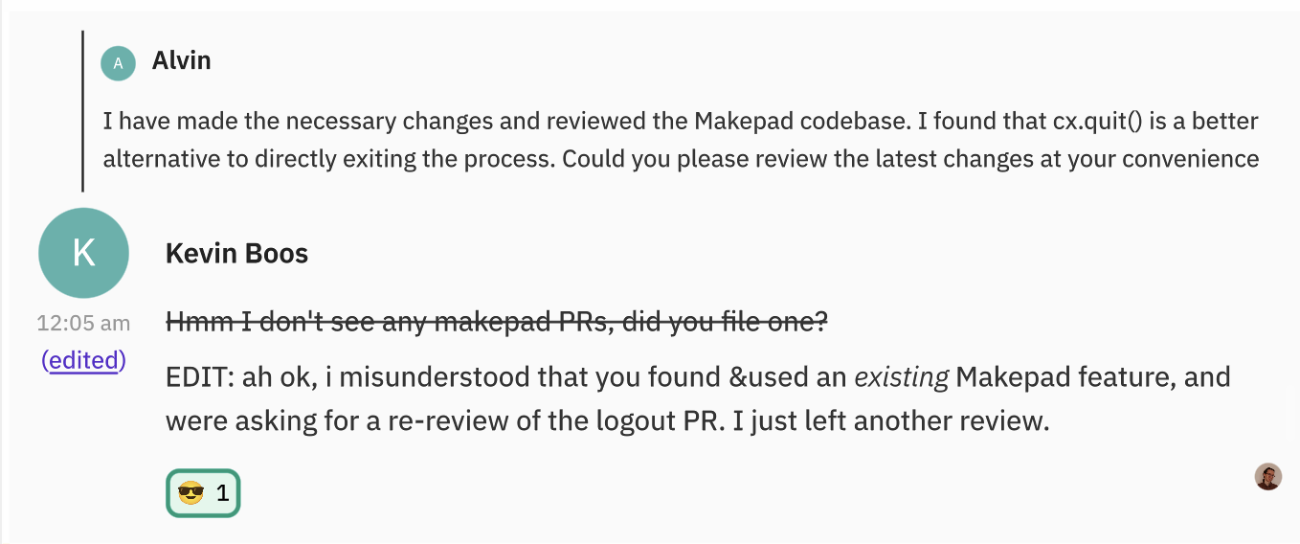
live_design! {
// The view used for each text-only message event in a room's timeline.
Message = {{Message}} {
width: Fill, height: Fit,
flow: Down,
show_bg: true
draw_bg: { ... }
animator: {
on_highlight = { ... }
on_hover = { ... }
}
// A preview of an earlier message that this message was in reply to.
replied_to_message = <RepliedToMessage> {
visible: false
flow: Right
margin: { bottom: 3, top: 10 }
replied_to_message_content = { ... }
}
body = <View> {
width: Fill, height: Fit
padding: {top: 0, bottom: 10, left: 10, right: 10},
flow: Right,
profile = <View> {
align: {x: 0.5, y: 0.0} // centered horizontally, top aligned
width: 65.0, height: Fit,
margin: {top: 5, right: 10}
flow: Down,
avatar = <Avatar> { width: 48, height: 48 }
timestamp = <Timestamp> { }
edited_indicator = <EditedIndicator> { }
}
content = <View> {
width: Fill, height: Fit
flow: Down,
<View> {
flow: Right,
width: Fill, height: Fit,
username = <Label> {
width: Fill,
flow: Right, // do not wrap
margin: {bottom: 10.0, top: 20.0, right: 10.0,}
draw_text: {
text_style: <USERNAME_TEXT_STYLE> {},
color: (USERNAME_TEXT_COLOR)
wrap: Ellipsis,
}
text: "<Username here>"
}
}
message = <HtmlOrPlaintext> { }
<View> {
width: Fill, height: Fit
reaction_list = <ReactionList> { }
avatar_row = <AvatarRow> {}
}
}
}
}
}
live_design! {
Message = {{Message}} {
width: Fill, height: Fit, flow: Down,
show_bg: true,
draw_bg: { ... }
animator: {
on_highlight = { ... }
on_hover = { ... }
}
// Preview of an earlier message that this message replied to.
replied_to_message = <RepliedToMessage> {
visible: false
flow: Right
margin: { bottom: 3, top: 10 }
replied_to_message_content = { ... }
}
body = <View> {
width: Fill, height: Fit
padding: {top: 0, bottom: 10, left: 10, right: 10},
flow: Right,
profile = <View> {
align: {x: 0.5, y: 0.0}
width: 65.0, height: Fit,
margin: {top: 5, right: 10}
flow: Down,
avatar = <Avatar> { width: 48, height: 48 }
timestamp = <Timestamp> { }
edited_indicator = <EditedIndicator> { }
}
content = <View> {
width: Fill, height: Fit
flow: Down,
username = <Label> {
draw_text: {
text_style: <USERNAME_TEXT_STYLE> {},
color: (USERNAME_TEXT_COLOR)
wrap: Ellipsis,
}
text: "<Username here>"
}
message = <Html> { }
<View> {
width: Fill, height: Fit, flow: Right,
reaction_list = <ReactionList> { }
avatar_row = <AvatarRow> {}
}
}
}
}
}
Example:
The UI code for a Message, using Makepad’s live DSL

Slide 16
live_design! {
// The view used for each text-only message event in a room's timeline.
Message = {{Message}} {
width: Fill, height: Fit,
flow: Down,
show_bg: true
draw_bg: { ... }
animator: {
on_highlight = { ... }
on_hover = { ... }
}
// A preview of an earlier message that this message was in reply to.
replied_to_message = <RepliedToMessage> {
visible: false
flow: Right
margin: { bottom: 3, top: 10 }
replied_to_message_content = { ... }
}
body = <View> {
width: Fill, height: Fit
padding: {top: 0, bottom: 10, left: 10, right: 10},
flow: Right,
profile = <View> {
align: {x: 0.5, y: 0.0} // centered horizontally, top aligned
width: 65.0, height: Fit,
margin: {top: 5, right: 10}
flow: Down,
avatar = <Avatar> { width: 48, height: 48 }
timestamp = <Timestamp> { }
edited_indicator = <EditedIndicator> { }
}
content = <View> {
width: Fill, height: Fit
flow: Down,
<View> {
flow: Right,
width: Fill, height: Fit,
username = <Label> {
width: Fill,
flow: Right, // do not wrap
margin: {bottom: 10.0, top: 20.0, right: 10.0,}
draw_text: {
text_style: <USERNAME_TEXT_STYLE> {},
color: (USERNAME_TEXT_COLOR)
wrap: Ellipsis,
}
text: "<Username here>"
}
}
message = <HtmlOrPlaintext> { }
<View> {
width: Fill, height: Fit
reaction_list = <ReactionList> { }
avatar_row = <AvatarRow> {}
}
}
}
}
}
live_design! {
Message = {{Message}} {
width: Fill, height: Fit, flow: Down,
show_bg: true,
draw_bg: { ... }
animator: {
on_highlight = { ... }
on_hover = { ... }
}
// Preview of an earlier message that this message replied to.
replied_to_message = <RepliedToMessage> {
visible: false
flow: Right
margin: { bottom: 3, top: 10 }
replied_to_message_content = { ... }
}
body = <View> {
width: Fill, height: Fit
padding: {top: 0, bottom: 10, left: 10, right: 10},
flow: Right,
profile = <View> {
align: {x: 0.5, y: 0.0}
width: 65.0, height: Fit,
margin: {top: 5, right: 10}
flow: Down,
avatar = <Avatar> { width: 48, height: 48 }
timestamp = <Timestamp> { }
edited_indicator = <EditedIndicator> { }
}
content = <View> {
width: Fill, height: Fit
flow: Down,
username = <Label> {
draw_text: {
text_style: <USERNAME_TEXT_STYLE> {},
color: (USERNAME_TEXT_COLOR)
wrap: Ellipsis,
}
text: "<Username here>"
}
message = <Html> { }
<View> {
width: Fill, height: Fit, flow: Right,
reaction_list = <ReactionList> { }
avatar_row = <AvatarRow> {}
}
}
}
}
}
The UI code for a Message, using Makepad’s live DSL

Slide 17
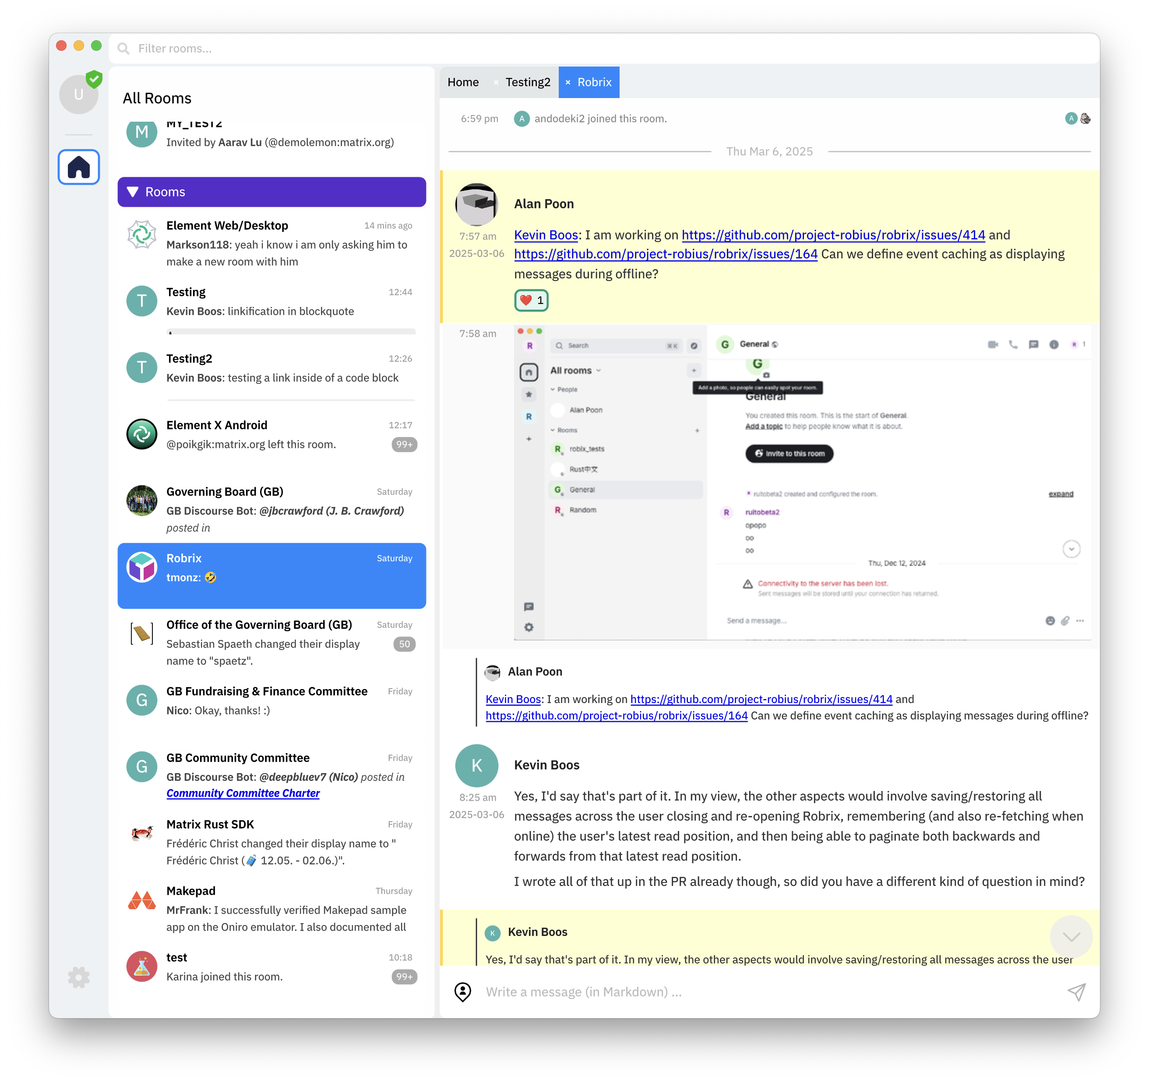
Views, custom Widgets, and composing them
RoomScreen
Timeline (PortalList)
SmallStateEvent
DayDivider
CondensedImageMessage
Message
ReplyPreview
Avatar, Username, Timestamp
HTML or plaintext content
Reactions
Seen-by users (AvatarSet)
RoomInputBar
Location icon button
MentionableTextInput
Send button

Slide 18
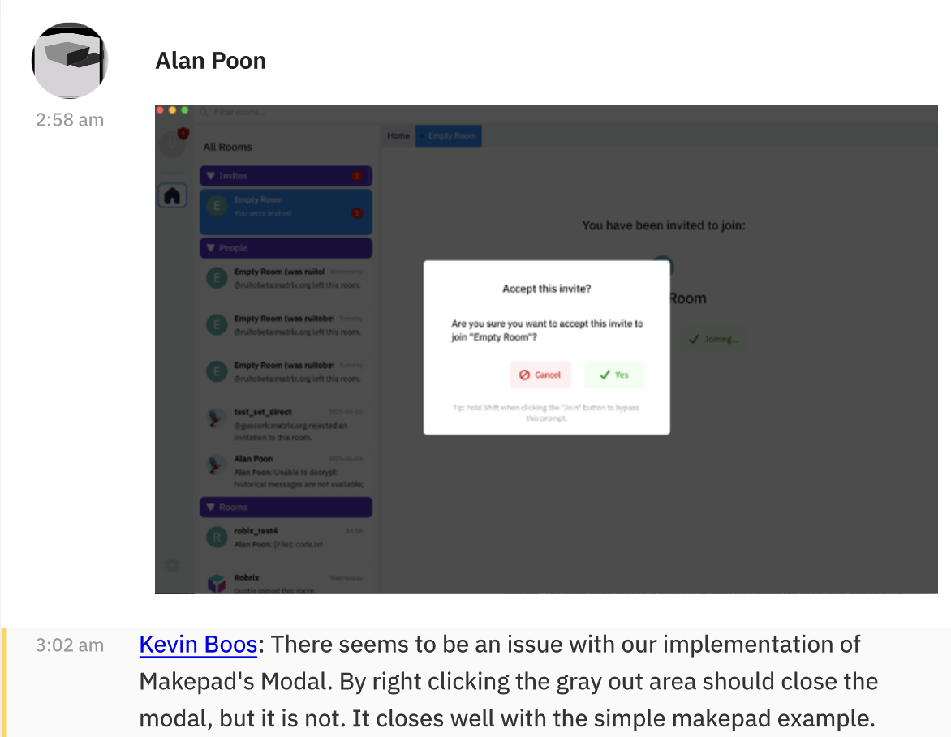
live_design! {
// The view used for each text-only message event in a room's timeline.
Message = {{Message}} {
width: Fill, height: Fit,
flow: Down,
show_bg: true
draw_bg: { ... }
animator: {
on_highlight = { ... }
on_hover = { ... }
}
// A preview of an earlier message that this message was in reply to.
replied_to_message = <RepliedToMessage> {
visible: false
flow: Right
margin: { bottom: 3, top: 10 }
replied_to_message_content = { ... }
}
body = <View> {
width: Fill, height: Fit
padding: {top: 0, bottom: 10, left: 10, right: 10},
flow: Right,
profile = <View> {
align: {x: 0.5, y: 0.0} // centered horizontally, top aligned
width: 65.0, height: Fit,
margin: {top: 5, right: 10}
flow: Down,
avatar = <Avatar> { width: 48, height: 48 }
timestamp = <Timestamp> { }
edited_indicator = <EditedIndicator> { }
}
content = <View> {
width: Fill, height: Fit
flow: Down,
<View> {
flow: Right,
width: Fill, height: Fit,
username = <Label> {
width: Fill,
flow: Right, // do not wrap
margin: {bottom: 10.0, top: 20.0, right: 10.0,}
draw_text: {
text_style: <USERNAME_TEXT_STYLE> {},
color: (USERNAME_TEXT_COLOR)
wrap: Ellipsis,
}
text: "<Username here>"
}
}
message = <HtmlOrPlaintext> { }
<View> {
width: Fill, height: Fit
reaction_list = <ReactionList> { }
avatar_row = <AvatarRow> {}
}
}
}
}
}
// A regular Message that shows an image, not text.
ImageMessage = <Message> {
body = {
// The `profile` view is inherited from `Message`,
// so we don’t need to change it here.
content = {
width: Fill, height: Fit
padding: { left: 10.0 }
message = <Image> { }
v = <View> {
width: Fill, height: Fit, flow: Right
reaction_list = <ReactionList> { }
avatar_row = <AvatarRow> {}
}
}
}
}
// A condensed message comes right after another message
// from the same sender, so it doesn’t show their avatar/name.
CondensedMessage = <Message> {
body = {
profile = <View> {
align: {x: 0.5, y: 0.0}
width: 65.0, height: Fit, flow: Down,
timestamp = <Timestamp> { }
edited_indicator = <EditedIndicator> { }
tsp_sign_indicator = <TspSignIndicator> { }
}
// The `content` view is inherited from `Message`,
// so we don’t need to change it here.
}
}
DSL inheritance makes it easy to extend, customize, or re-style your widgets

Slide 19

Connecting UI DSL code to Rust logic: → Event handling is simple via DSL queries
impl Widget for RoomInputBar {
fn handle_event(&mut self, cx: &mut Cx, event: &Event, ...) {
if let Event::Action(actions) = event {
// Handle the send message button click or Enter being pressed.
let msg_input = self.text_input(id!(message_input));
if self.button(id!(send_message_button)).clicked(actions)
|| msg_input.returned(actions).is_some()
{
let text = msg_input.text().trim();
if !text.is_empty() {
let message = create_message_with_mentions(&text);
submit_async_request(MatrixRequest::SendMessage {
room_id,
message,
replied_to: self.tl_state.as_mut()
.and_then(|tl| tl.replying_to.take()),
})
self.clear_replying_to(cx);
msg_input.set_text(cx, "");
room_input_bar.enable_send_message_button(cx, false);
}
}
}
}
pub RoomInputBar = {{RoomInputBar}} {
location_button = <RobrixIconButton> {
spacing: 0,
draw_icon: { svg_file: (ICON_LOCATION_PERSON) }
icon_walk: { width: Fit, height: 23 }
}
message_input = <TextInput> {
empty_text: "Write a message (in Markdown)..."
}
send_message_button = <RobrixIconButton> {
// Only enabled when text is inputted
enabled: false,
draw_icon: {
svg_file: (ICON_SEND),
color: (COLOR_FG_DISABLED),
}
draw_bg: { color: (COLOR_BG_DISABLED) }
}
}
submit_async_request(MatrixRequest::SendMessage {
room_id,
message,
replied_to: self.tl_state.as_mut()
.and_then(|tl| tl.replying_to.take()),
})

Slide 20
Leverage Rust for max performance: safely and easily offload I/O & computation off of the main UI thread
submit_async_request(MatrixRequest::SendMessage {
room_id,
message,
replied_to: self.tl_state.as_mut()
.and_then(|tl| tl.replying_to.take()),
})
async fn async_matrix_worker(
mut request_receiver: UnboundedReceiver<MatrixRequest>,
) -> Result<()> {
while let Some(request) = request_receiver.recv().await {
match request {
MatrixRequest::SendMessage { room_id, msg, replied_to } => {
let timeline = get_room_timeline(&room_id) else { ... };
// Spawn a new async task that will send the actual message.
Handle::current().spawn(async move {
let result = if let Some(replied_to_info) = replied_to {
timeline.send_reply(msg, replied_to_info).await
} else {
timeline.send(msg).await
};
Cx::post_action(TimelineUpdate::SentMessage(result));
});
}
static REQUEST_SENDER:
OnceLock<UnboundedSender<MatrixRequest>> = ...;
pub fn submit_async_request(req: MatrixRequest) {
REQUEST_SENDER.get().send(req)
}
impl Widget for RoomInputBar {
fn handle_event(&mut self, event: &Event, ...) {
if let Event::Action(actions) = event {
match actions.cast() {
TimelineAction::SentMessage(res) => {
// Update UI here with send result
}
Main UI thread
Background async task

Slide 21
Maintaining performance & responsiveness in the face of mixed concurrency contexts
direct function call
sync –> sync channel
sync –> async channel
async –> sync channel
non-blocking requests to async funcs
responses from async funcs;
Channels or Makepad Actions
UI main thread
Background thread in async runtime pool
App main loop, draw routines, event handlers
Background thread
non-blocking requests to bkgd (sync) functions
App logic calling async platform APIs
App logic calling sync platform APIs
Nested sync requests, which may also need async functions
App logic using SDKs
non-blocking
content lookup (fast path)
Makepad UI toolkit
content cache (shared memory)
insert fetched content (sync)
insert fetched content (async)
Robius Platform Abstractions
Services/SDKs
Platform/OS Native Layers
Notes:
App main thread is managed by and talks to the Makepad UI toolkit
Obviously want to avoid blocking this thread at all costs
Sends off requests that require synchronous operations to background threads
Sends of requests that require async operations to background threads that are managed by an async executor that can run async tasks
Certain platform-specific functions must only be invoked on main thread
But, many service SDKs are built atop async/await
e.g., the Matrix SDK requires async for many of its features (exposes only async fn()s)
Should not run async workloads on UI main thread
We have other non-async work that we also want to in the background
In total, we must contend with 3 categories of workloads
Currently use multiple types of channels, queues, and condvars to facilitate inter-context communication
Aim to create a better design here that helps to abstract away the manual tedium of passing messages across many kinds of channels

Slide 22
Robius crates offer easy access to native platform APIs
Easily query current location
Get & manage canonical directories for each platform, including mobile
struct LocationHandler;
impl robius_location::Handler for LocationHandler {
fn handle_update(&self, location: Location<'_>) {
match location.coordinates() {
Ok(coordinates) => {
Cx::post_action(LocationAction::Update {
coordinates,
time: location.time().ok(),
});
}
Err(e) => Cx::post_action(LocationAction::Error(e)),
}
}
...
let mgr = Manager::new(LocationHandler)?;
mgr.request_auth(Access::Foreground, Accuracy::Precise)?;
mgr.update_once(); // or start_updates(), stop_updates()
let project_dirs = robius_directories::ProjectDirs::from(
"org", "robius", "robrix",
);
let app_data_dir = project_dirs.data_dir();
let cache_dir = project_dirs.cache_dir();
// Easily access storage & cache save_persistent_app_data_to(&app_data_dir);
clear_app_cache(&cache_dir);
and many more features...

Slide 23
Integrating TSP into Robrix
the Trust Spanning Protocol

Slide 24
Decentralized Identity Verification with TSP
TSP facilitates effective trust relationships over an untrusted network (e.g., the internet)
Authenticity: sender is who they say they are; message contents are untampered
Confidentiality: Only the chosen receiver can read the message (if encrypted)
Metadata privacy, including protection through untrusted intermediaries
No central authority required to act as the “trust provider”
Persistent long-term identities are managed by wallets local to each endpoint system
Intermediary System
Intermediary System
End System A
TSP
Trust Spanning Protocol
End System B
Privileged and Unprivileged Supporting Systems
Diagrams courtesy of Wenjing Chu
Notes:
Modes of operation
Direct mode: TSP messages can be exchanged directly between two parties via publicly known VID's ("Well-Known VID's"); that gives confidentiality and authenticity but not much privacy.
Nested mode: TSP messages can be exchanged as the 'payload' of another TSP message using not-publicly known VID's. Such a nested connection is established via TSP Control Messages. This gives a little bit more privacy.
Routed mode: TSP messages can be routed through intermediaries to further hide the fact that two parties are communicating. This is done by parties first establishing "nested" communication lines between every involved party and then sending a message that spans over those nested communications lines.

Slide 25
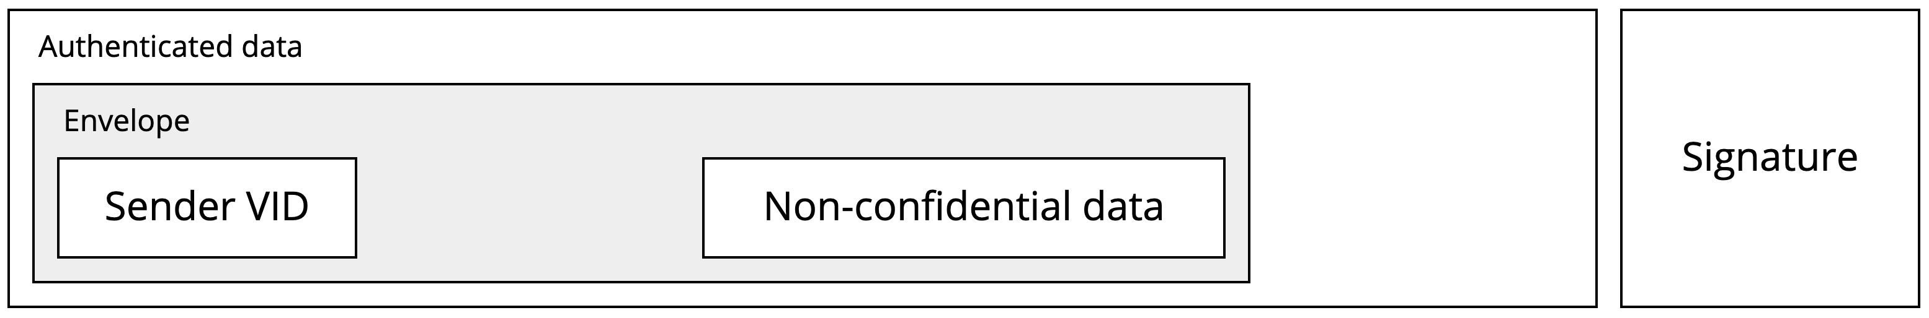
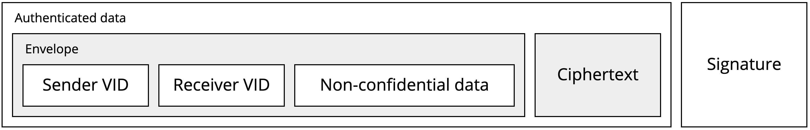
TSP as used in Robrix
🌐 ^{p.teaspoon.world}
🌐 ^{q.teaspoon.world}
We use non-confidential signed messages in public rooms:
Intermediary System
Intermediary System
End System A
TSP
Trust Spanning Protocol
End System B
We can use confidential encrypted messages in direct rooms:
https://
Privileged and Unprivileged Supporting Systems
🌐 ^{did.teaspoon.world}
TSP Spec: https://trustoverip.github.io/tswg-tsp-specification/
TSP SDK: https://github.com/openwallet-foundation-labs/tsp
Notes:
Modes of operation
Direct mode: TSP messages can be exchanged directly between two parties via publicly known VID's ("Well-Known VID's"); that gives confidentiality and authenticity but not much privacy.
Nested mode: TSP messages can be exchanged as the 'payload' of another TSP message using not-publicly known VID's. Such a nested connection is established via TSP Control Messages. This gives a little bit more privacy.
Routed mode: TSP messages can be routed through intermediaries to further hide the fact that two parties are communicating. This is done by parties first establishing "nested" communication lines between every involved party and then sending a message that spans over those nested communications lines.

Slide 26
TSP features implemented by Robrix
Create & manage wallets
Persist/recover wallets to/from secure storage
Create and (re)publish Decentralized IDentities (DIDs)
Verify other users’ identities into your local wallet
Associate a verified ID with a Matrix User ID
Sign a Matrix message with your TSP ID when sending it out
Send/receive direct TSP messages over TCP/HTTPS
As well as TSP data via Matrix as a transport

Slide 27
Video demo of TSP atop Matrix

Slide 28
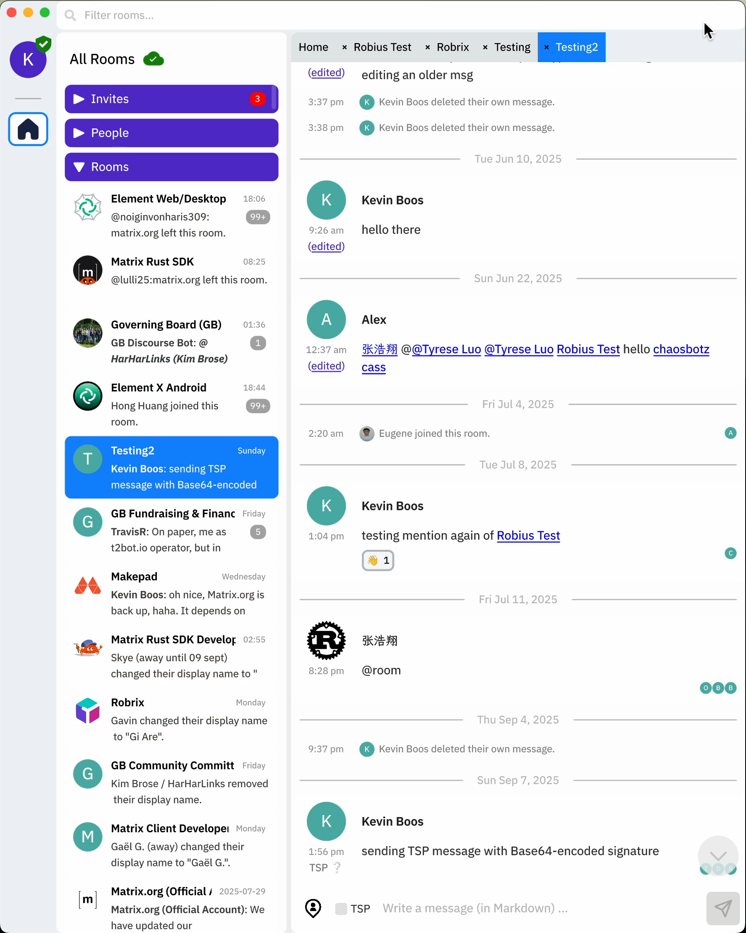
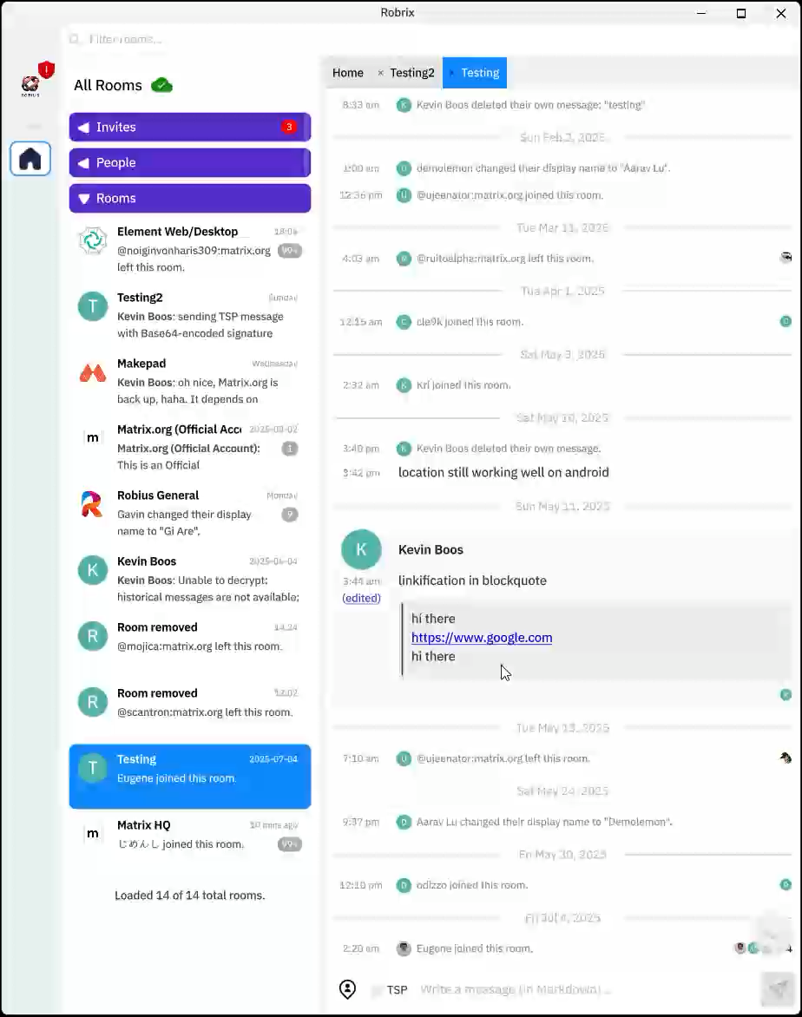
TODO: add videos here

Slide 29
⚠️ Warnings when TSP signatures don’t match! ⚠️

Slide 30
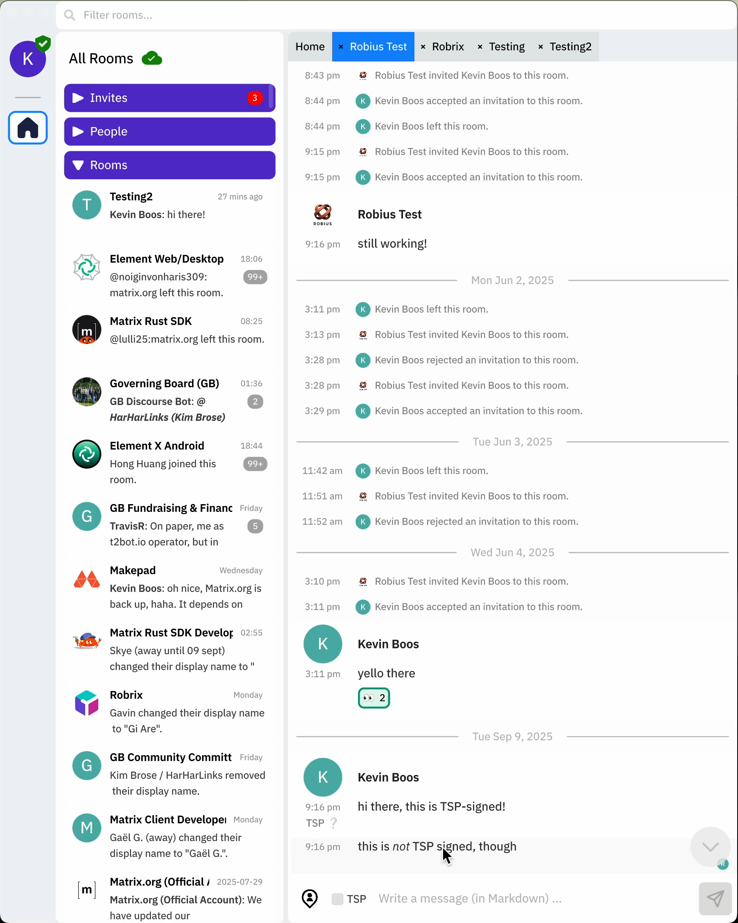
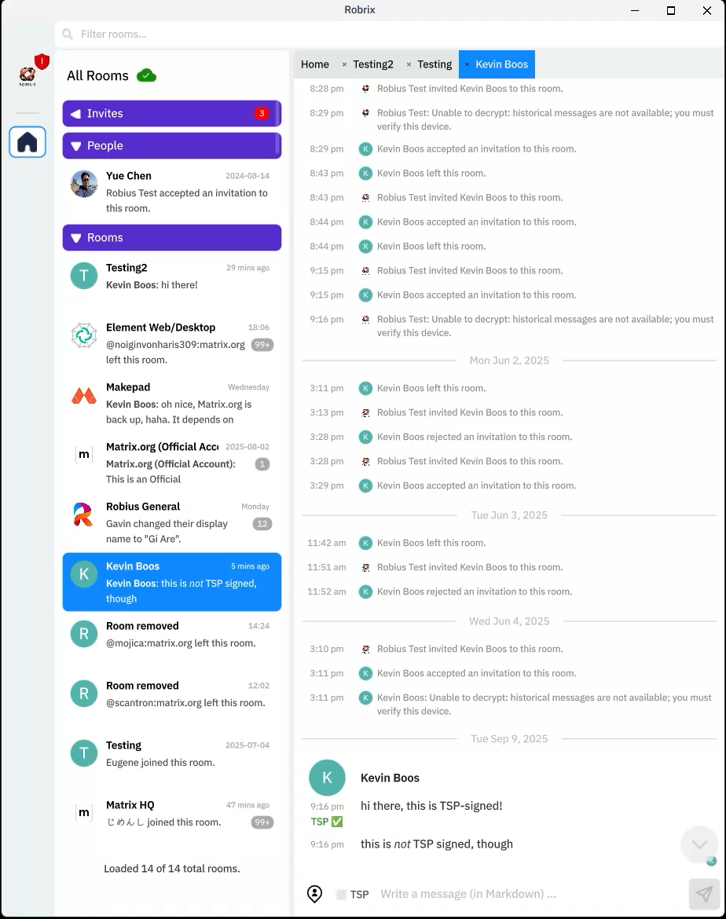
TODO: add videos here

Slide 31
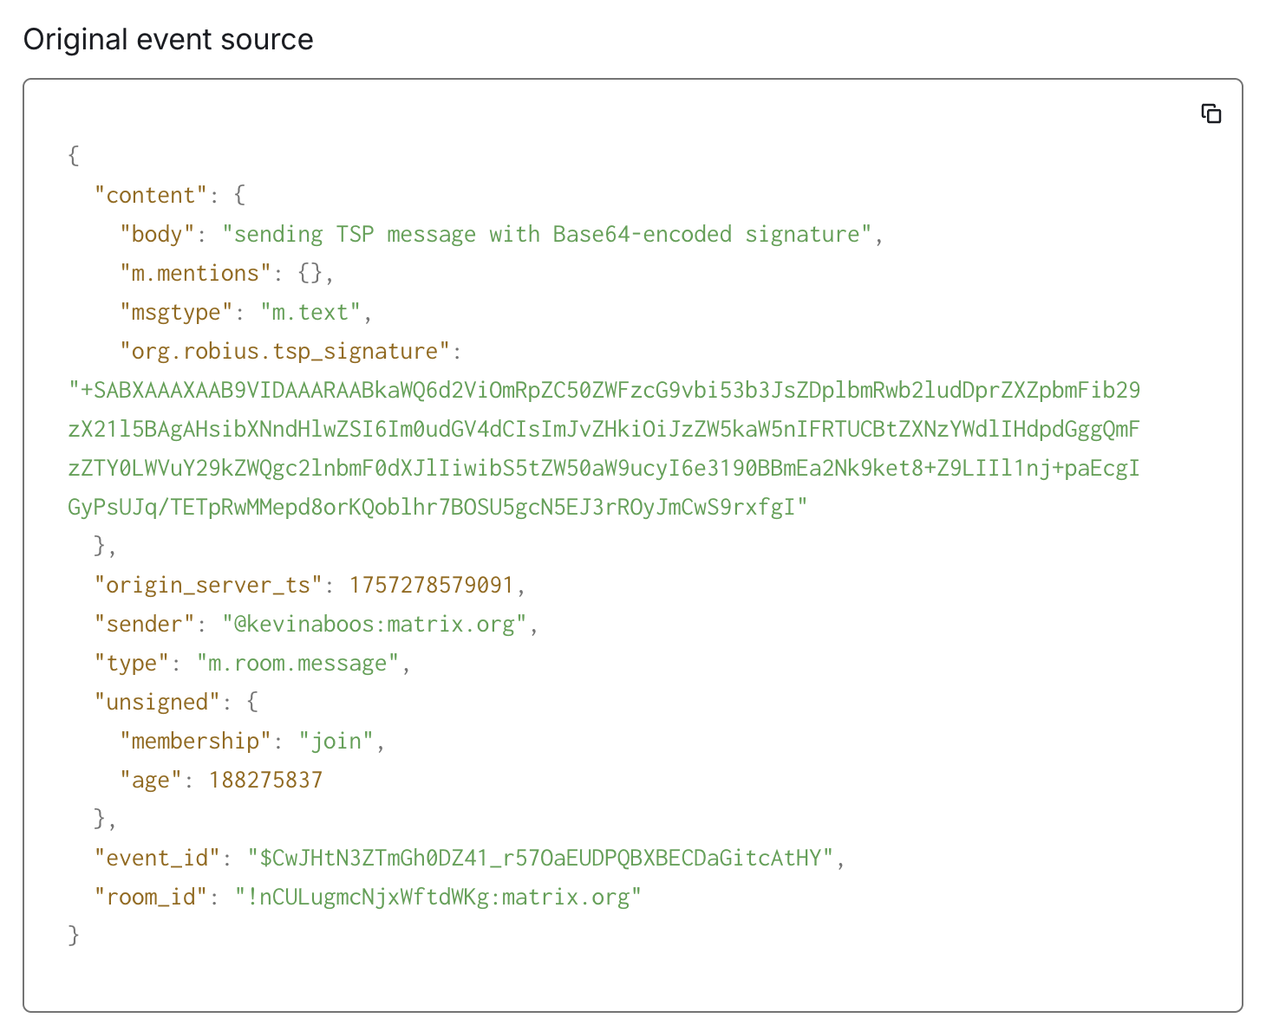
TSP signature is injected into Matrix message
Compliant with Matrix Spec ✅
Doesn’t affect other clients; can be freely ignored
Currently includes the full message (Base64-encoded)
Will add TSP SDK support for extracting message payload out of signed byte array

Slide 32
Use cases & benefits of TSP atop Matrix
An additional layer of ID verification beyond Matrix
Autonomously prove an identity (“I am who I say I am”) and the message’s authenticity
Show a smoke signal warning if someone’s signature changes
Prevents false identity scams like “pig butchering”/杀猪盘
Double encryption for direct (1-on-1) messages
Decryption requires locally-available state in secure TSP wallet; attacker can’t read messages even if they compromise your Matrix account
Identities are portable, not tied to or limited to Matrix
Can take your verified relationships with you to a new Matrix account, or port them over to a new service entirely (e.g., Mastodon, Bluesky)
Relationships (creditable endorsements) can be referred:
“Your trusted contact Bob verifies that a new user Alice is actually Alice”

Slide 33
Concluding Remarks

Slide 34
Wrapping up, but looking forward
You can now use Rust to build complex, real-world apps! 🚀
Makepad + Robius enable high performance UI/UX amidst very demanding use cases
Offers consistent, deep system integration across multiple platforms
Many challenges still remain
Simplifying UI design, more platform features, better build tooling
Deeper TSP integration: referrals, nested relationships, double encryption
For more, check out our blog: robius.rs/blog/
Looking forward to continued collaboration with other Rust UI/App project organizations, and the Rust lang/libs/tools teams

Slide 35





Roadmap (in no particular order)
Expand Makepad’s UI widget collection and input event support
Ensure consistent coverage for app lifecycle events
Continue developing key platform feature abstraction crates
Focus on mobile platform APIs, for truly immersive apps
Backfill OpenHarmony support into existing Robius (and other) crates
Better, more automated build tooling
Auto-detection + generation of required app permissions/entitlements
Publish flagship apps to app stores & package managers
Under the stewardship of the GOSIM organization
More docs and guided tutorials for Makepad + Robius app dev

Slide 36














Acknowledgments
Rik Arends
Edward Tan
Alex Zhang
Poon Yong Quan (Alan)
Klim Tsoutsman
Sebastian Michailidis
Julian Montes de Oca
Alvin
Tyrese Luo
Cassaundra Smith
Yiming (Aarav) Lu
Guo KeZhen (Cork)
Eddy Bruël
Jorge Bejar

Slide 37





Thanks!
Interested? Please reach out:
@project-robius
#robius@matrix.org @kevinaboos
https://makepad.nl
https://robius.rs

Slide 40

Joint Project Goals
Notes:
Project Robius has quite a few goals and technical requirements, which you can read about in full on our website or github page.
For now, in the interest of time, I’m going to just discuss a select few.

Slide 41
Goals for Makepad & Robius together
Achieve feature completeness across entire stack
Full set of UI widgets, with support for themeing, i18n, etc
Platform feature abstractions for deep system integration
Build tooling for packaging/publishing app bundles
Create flagship apps: beautiful, polished, and performant with well-structured code that serves to exemplify best practices
Makepad Studio: a full IDE with unique features, for desktop
Robrix: a Matrix chat client & more, for all platforms
Moly: a GUI client for local + cloud-based AI LLMs (desktop)
The better the app, the stronger the case for Rust app dev!
Notes:
There are quite a few projects that experiment with how to build a great GUI using Rust; Dioxus, tauri, makepad, Xilem and the linebender project, etc. But to build a fully-featured app these days, you need an awful lot more than just UI and basic input events. That's what Project Robius is all about: we leave UI design to the experts, and step in to fill the gaps everywhere else in the app dev environment. This includes everything from complex build systems, support for platform-specific APIs and OS services (with nice Rust abstractions for each class of functionality), signing/packaging/bundling/distributing apps, and more. Everything is entirely open-source and decentralized. Nothing is owned or controlled by one party, and we welcome contributions from anyone and everyone.

Slide 42
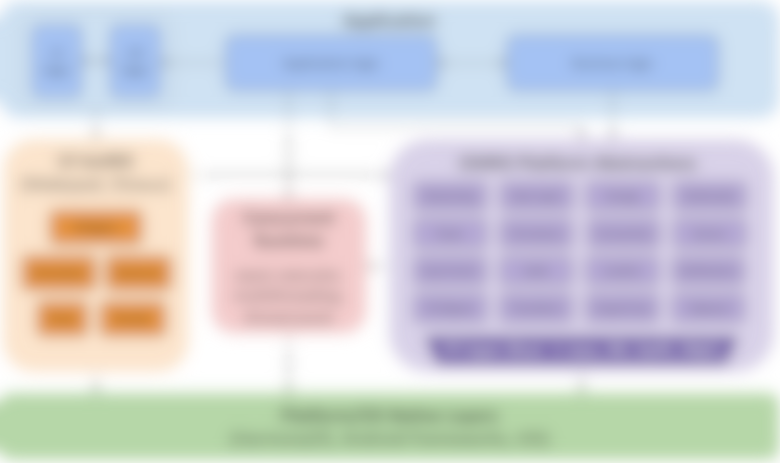
Reference design of the full system stack
Application
UI logic
UX logic
Application logic
Business logic
Runtime components pictured.
Build tooling is not shown.
UI toolkit (Makepad)
Robius Platform Abstractions
Concurrency Mgmt library
Networking
Location
Storage
Multimedia
Widgets
Power
Permissions
Connectivity
Sensors
main UI thread token
async tasks
Animation
Actions
Other Events
Keychain
Dialogs
Notifications
Events
Drawing
IPC/Signals
Timer/Alarm
Drag & Drop
Clipboard
bkgd thread workloads
comm. primitives
FFI layer (Rust → native language)
Platform/OS Native Layers (Linux, macOS, Windows, Android, iOS, Web, OpenHarmony …)
details coming later…
Notes:
Our primary goal is to establish a complete, working example of everything beneath the app
Which must support major platforms/OS environments
UI toolkits – Makepad, Dioxus, Slint
Offers a variety of UI development options and styles
Generally cross-platform, with a focus on GUI design and workloads
Rust abstractions of platform and OS-specific functionality
Focus on non-GUI subsystems
Standard subsystems: networking, storage, audio, time
UI-adjacent services: notifications, clipboard, drag & drop
Mobile-oriented:
Sensors/actuator: accelerometer/gyro, ambient light, pressure, temp, vibration, location, buttons, LEDs, biometrics
Multimedia: camera, mic, speaker
Touch screen, display brightness
Connectivity: WiFi discovery, bluetooth, NFC, USB, phone modem
Power: battery, charging, idle/standby/awake status
Permissions management: declaring, requesting, revoking
Goal: easy to integrate into a UI app as a dependency
Low-/zero-cost abstractions, as close to native as possible
Future: high-level, off-system mobile services
RESTful APIs: mapping, authentication, Google Play services, etc
Can likely use or start from the foundation of Open Mobile Hub
App dev-focused Concurrency management framework/library
Speaking from personal experience, it can be quite cumbersome and difficult to integrate and balance together many different execution contexts
Async tasks, which many SDKs force upon the user
Native OS Threads
The almighty main UI thread, which often has significant platform-enforced responsibilities and powers – difficult to handle and properly remember what workloads can only be run on the main UI thread
Balancing
Communicating between all of these different contexts without
thread pools, and CPU/multicore abstractions

Slide 43
Application
Application
UI / UX
Architecture of the Robrix App (a Matrix chat client)
Robrix’s needs guide Robius development and implementation priority
Writing/using Robrix forces us to dogfood Robius components
and Makepad, of course
Added many new features to Makepad over the past ~2 years to support Robrix
Rooms list
Room view
Rooms browser
Application logic
Business logic (SDK use & more)
Persistent settings
Show notifs.
Local msg search
Jump to event
Event query
Join/ leave room
message send/recv
Read receipt
Settings, Themes
In-app notifs.
Context menus
Member info
Image viewer
Video display
Create or delete room
Quick replies
Access camera, mic, speaker
Login, session management
Account management
Reactions, read receipts
Search
Rich text format
Authentication
Multimedia streaming, calling
Input reaction
File/media dialog
Threaded view
UI ↔ SDK comm/sync
and more!
UI toolkit (Makepad)
Concurrency Mgmt library
Platform Abstractions
Concurrent Runtime
async executor, multithreading, thread pools
thread token: &mut Cx
Networking
Location
Storage/Cache
Multimedia
Widgets
async task pool
Input Events
Keychain
Connectivity
Notifications
Animation
Actions
channels, segqueues, etc
Authentication
Permissions
Dialogs
Clipboard
Events
Drawing
thread-local caches
FFI layer (Rust → native language)
Platform/OS Native Layers
Notes:
If we map this design of a full system stack to a specific app, it would look like this for Robrix.
Note that you obviously don’t need to understand every detail here.
In this case, we are also including the entire application component in the diagram, as we’re also responsible for developing.

Slide 44
demo time! for future/offline viewers: the demo included an overview of Robrix running on macOS & other platforms. Check out our git repos here and run them on your own machine: https://github.com/project-robius/robrix https://github.com/moxin-org/moly https://github.com/makepad/makepad
44
Notes:
go over structure of components we’ve designed
Custom HTML parser & renderer
Extremely lightweight, no web engine, no CSS
Custom caching layer for drawing & populating UI widgets
Able to integrate with fine-grained events from Matrix SDK

Slide 45
Major implementation challenges
⭐️
Realizing all the practical, unexciting UI features
Exposing & abstracting platform APIs / OS services
Handling complex multi-step builds (Rust + others)
Standardizing compilation of non-Rust system glue layers
Supporting platform-specific toolchains and linking conventions
Defining and executing pre- and post-compilation steps
Packaging: bundling, codesigning, distributing apps
Required for system notifications, geolocation (and so much more)
Maintaining high performance in the face of concurrency and async
Key objective: do “nothing” on main UI thread
But, UI & other select platform functions must run on “main” thread
Certain APIs require async, others forbid async
⭐️
all across
disparate
platforms
⭐️
Notes:
Robrix has driven a lot of our implementation efforts over the past year. Two of the most major categories of implementation work has been on the UI side and on the platform feature side.
Most of what you just saw in the Robrix demo did not exist in Makepad before last year, including basic things like rich text formatting, mouse button abstractions, context menus, “adaptive view” widgets that respond to changes in window size
Permissions handling
Collecting and merging permissions from app, UI toolkit, dependencies

Slide 46
Deep dive into a real app
The inner workings of Robrix
Notes:
Project Robius has quite a few goals and technical requirements, which you can read about in full on our website or github page.
For now, in the interest of time, I’m going to just discuss a select few.

Slide 47
Demystifying a complex Rust app
Goals
Go deeper than a visual demo
Give a feel for what app dev and UI design in Rust can look like
Show off select components
Inspire you to start using Makepad & Robius to build your own apps
Non-goals
Be a comprehensive tutorial
Make you an expert on Rust, Makepad, or UI dev
Advise on best design or implementation practices
For more, see the Makepad demo room/booth (3pm) or the Makepad workshop on Thursday
Notes:
Every time I see a cool Rust app being demo’d, I always wonder how it works internally,
and would like to see what the real code looks like and how everything fits together.
Demos are cool but they always leave me wanting more.
So, with that in mind, I’d like to give everyone a glimpse behind the curtain, even if it’s not as comprehensive as a full workshop or tutorial would be. Hopefully this will inspire you to start using Makepad and Robius to build your own complex, real applications.)

Slide 48
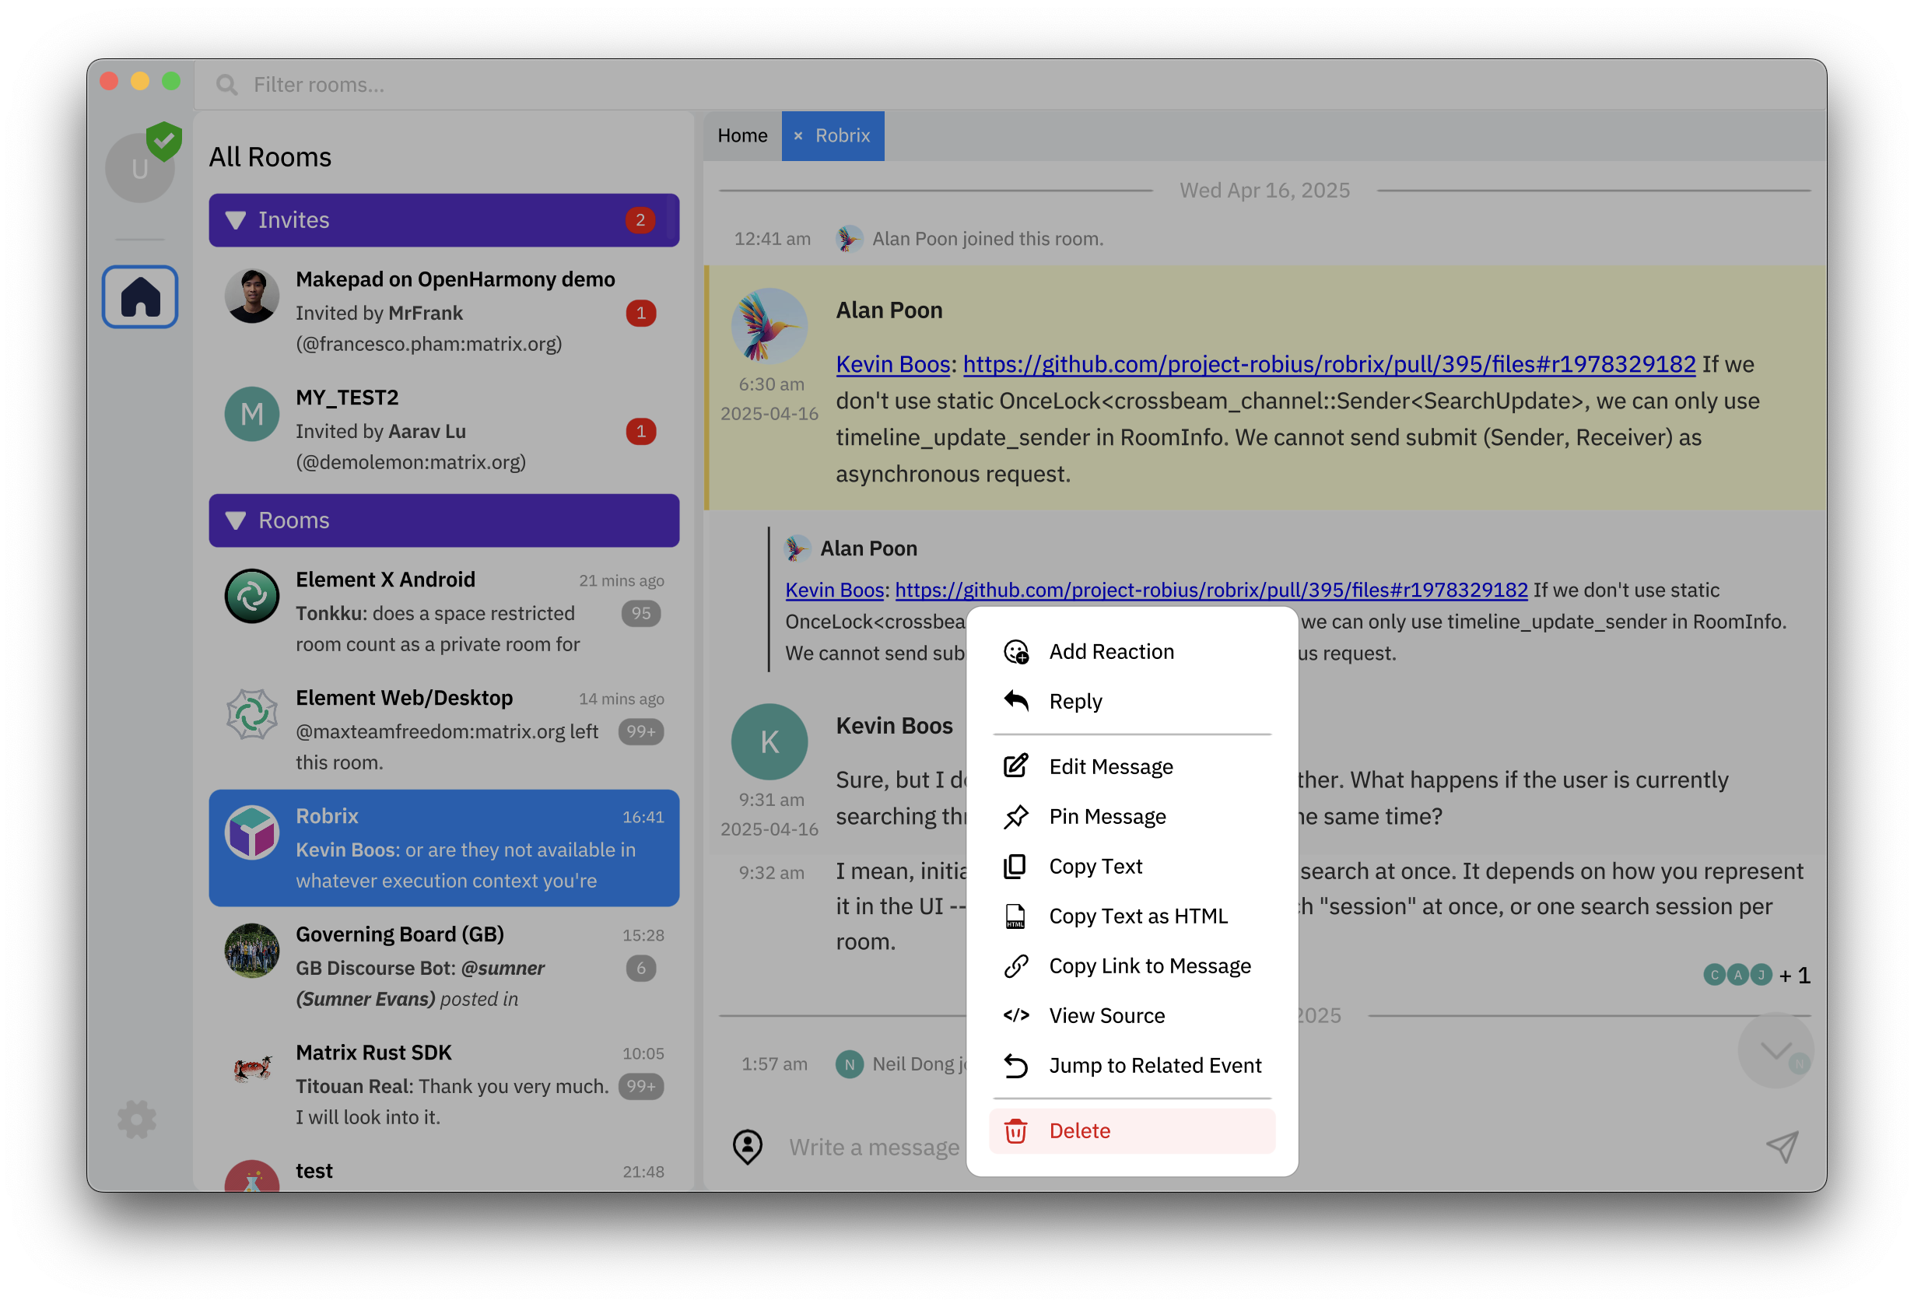
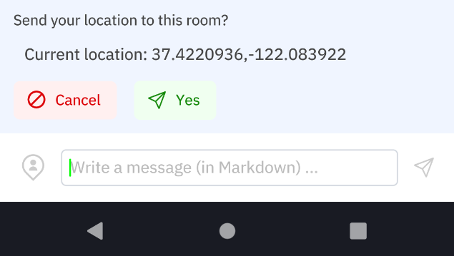
Outline: a deep dive into M+R via Robrix
The basic View/Widget structure
And how to compose multiple views
Handling native gestures (long-press)
How it’s triggered deep in the platform layer
How we abstract & deliver it to the app logic
Cross-widget interaction via Actions
e.g., long-pressing a Message widget will emit an action that tells the top-level App to show a custom context menu
Using native platform features easily
Sending your current location to a chat room using our robius-location crate

Slide 49
code exploration! Basic View/Widget composition with the LocationPreview
49
Notes:
go over structure of components we’ve designed
Custom HTML parser & renderer
Extremely lightweight, no web engine, no CSS
Custom caching layer for drawing & populating UI widgets
Able to integrate with fine-grained events from Matrix SDK

Slide 50
code exploration! Showing LocationPreview within a RoomScreen
50
Notes:
go over structure of components we’ve designed
Custom HTML parser & renderer
Extremely lightweight, no web engine, no CSS
Custom caching layer for drawing & populating UI widgets
Able to integrate with fine-grained events from Matrix SDK

Slide 51
Views, custom Widgets, and composing them
RoomScreen
Timeline (PortalList)
SmallStateEvent
DayDivider
CondensedImageMessage
Message
ReplyPreview
Avatar, Username, Timestamp
HTML or plaintext content
Reactions
Seen-by users (AvatarSet)
RoomInputBar
Location icon button
Message TextInput
Send button

Slide 52
Robrix widget tree (abridged)
TODO: rough sketch of Robrix app tree
And then we go through and highlight the path for a few scenarios that we need to
enable communication for,
and show what type of interaction is appropriate for each (types from the prior slide)
App
Login Screen
Message Context Menu
Home Screen
AdaptiveView
Overlay (gray bg)
Rounded View
Narrow (mobile)
Wide (desktop)
React button
StackNav
Spaces Bar
Search/filter bar
Main Dock UI
Reply button
root view
main view
Rooms list
Welcome Screen
Room Screen
Invite Screen
Copy text button
Welcome Screen
Timeline
ReplyPreview
LocationPreview
Room Input Bar
Spaces bar
Invite Screen
Portal List
Rooms list
Title label
View
Loc coords label
Location button
Room Screen
Message
TextInput
CondensedMessage
Send loc button
Cancel button
Send button
ImageMessage
Notes:
Here’s how the RoomScreen and its component widgets fit into the larger structure of the Robrix app.
Pictured here is a widget “tree” (with lots of things omitted for clarity).
The gray nodes are things that I won’t have time to cover in this talk, but are still listed in order to give you a feel for how the main pieces of the UI are composed.

Slide 53
Cross-entity interactions
Parent can directly invoke child functions
What about a child accessing parent state? Scope
Type-erased [im]mutable references to parent state
In event handlers & draw routines, this is passed from parent → child
Downcasted within child function for actual usage
What about sibling → sibling? Actions
Each kind of action defines its own custom enum
Widget → widget
Background task → widget
Broadcast? UI Signal
e.g., app-wide preferences just changed, so redraw yourself

Slide 54
Current Status
Notes:
Project Robius has quite a few goals and technical requirements, which you can read about in full on our website or github page.
For now, in the interest of time, I’m going to just discuss a select few.

Slide 55


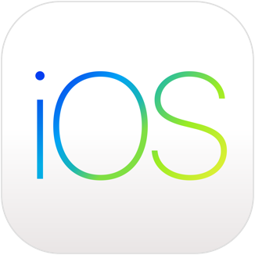




Most major platforms are already supported
Desktop
macOS
Linux (Debian-based, X11)
Windows
Mobile
Android
iOS
Web/WASM
✅ Makepad, 🚧 Robius
OpenHarmony OS
✅ Basic drawing, touch input, bundling/packaging
🚧 Deep platform support

Slide 56
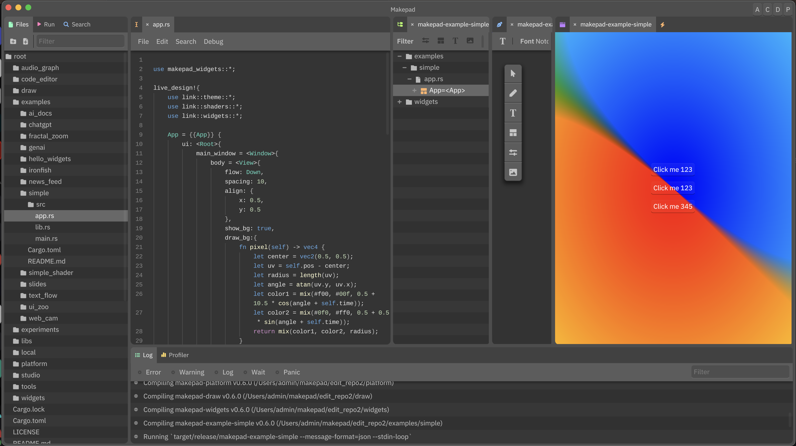
Makepad recently had its v1.0 release 🎉
Fundamental widget set is generally complete
Easy to arbitrarily compose
Internals still changing, but public API is stabilizing
Most platform integrations fully work
Native rendering, input events, drag-n-drop, clipboard, multimedia
Missing / non-UI features are being filled in by our Project Robius crates
Makepad Studio IDE (above) is minimal yet ready for daily use
Visual Designer (drag-n-drop UI programming) is in progress

Slide 57
Targeted platform abstractions / OS service APIs
System notifications
Biometrics & authentication
File/image picker dialogs
Context menus (custom, native)
Menu bar (desktop only)
Clipboard: plaintext, rich content
Drag & Drop
Default URI/Intent handling
Content sharing to foreign app
Native font access
Input Method Editors (IME)
Native gesture recognition
Connectivity management
WiFi, Bluetooth, NFC, nearby devices
GPS/Location access
Multimedia capture
Device discovery & configuration
Camera – snapshots, video, settings
Audio – input, MIDI, playback
Sensors
Native alarms, timers
Keychain (secret storage)
Power management/status
App lifecycle state transitions
OS-standard data directories
and so much more …

Slide 58
Platform feature status (early 2025)
System notifications
Biometrics & authentication
File/image picker dialogs
Context menus (custom, native)
Menu bar (desktop only)
Clipboard: plaintext, rich content
Drag & Drop
Default URI/Intent handling
Content sharing to foreign app
Native font access
Input Method Editors (IME)
Native gesture recognition
Connectivity management
WiFi, Bluetooth, NFC, nearby devices
GPS/Location access
Multimedia capture
Device discovery & configuration
Camera – snapshots, video, settings
Audio – input, MIDI, playback
Sensors
Native alarms, timers
Keychain (secret storage)
Power management/status
App lifecycle state transitions
OS-standard data directories
and so much more …
Notes:
Most of these, but not all, are useful within Robrix but not technically mandatory.
Approximate proposed order:
Biometrics/authentication
Open URI / share object to another app (Intents, “sharesheet”)
Geolocation
System notifications
Native file/image picker dialog
Native font access (fallback for UI-packaged font stack)
Registration as default app (Intent handler)
Native rich clipboard access with full-MIME types
Native context menus

Slide 59



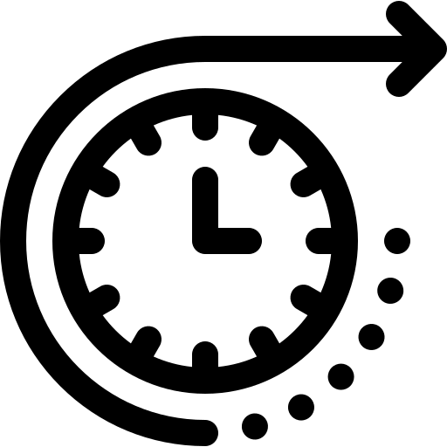



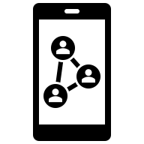



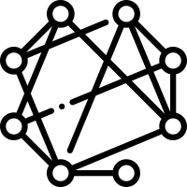

Roadmap (in no particular order)
Expand Makepad’s UI widget collection and input event support
Ensure consistent coverage for app lifecycle events
Continue developing key platform feature abstraction crates
Focus on mobile platform APIs, for truly immersive apps
Backfill OpenHarmony support into existing Robius (and other) crates
Better, more automated build tooling
Auto-detection + generation of required app permissions/entitlements
Publish flagship apps to app stores & package managers
The GOSIM organization can provide FOSS stewardship for our apps
More docs and guided tutorials for Makepad + Robius app dev
Notes:
e.g., some things that we’re still working on are long clicks on iOS, OpenHarmony, drag-n-drop on Linux & Android

Slide 60
Wrapping up, but looking forward
Makepad + Robius are now usable for complex, real-world apps
Enables high performance amidst very demanding use cases
Offers consistent, deep system integration across multiple platforms
Many challenges still remain
Simpler UI design, more platform features, better build tooling
Looking forward to continued collaboration with other Rust UI/App project organizations, and the Rust lang/libs/tools teams
Deeper TSP integration: referrals, nested relationships, double encryption
For more, check out two recent blog posts: robius.rs/blog/
A 2024 retrospective, and 2025 roadmaps for Robius and Robrix

